Slide 1
BRITISH COUNCIL PROGRAMME IN SUPPORTING SOCIAL ENTERPRISE IN INDONESIA
Indonesia development forum
Jakarta, 9-10 august 2017

Slide 2
About british council
We are the UK’s international organisation for cultural relations and educational opportunities.
Founded in 1934, we are a UK charity governed by Royal Charter and a UK public body.
We operate in Indonesia since 1948.
We work with over 100 countries across the world.

Slide 3
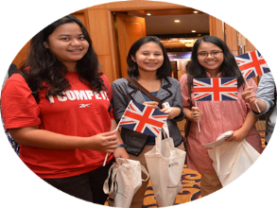
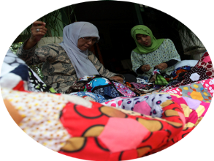
About british council
Making a positive contribution to the UK and the countries we work with – changing lives by creating opportunities, building connections and engendering trust.
We do this through our work in:
Arts and Culture
English
Education
Civil Society

Slide 4
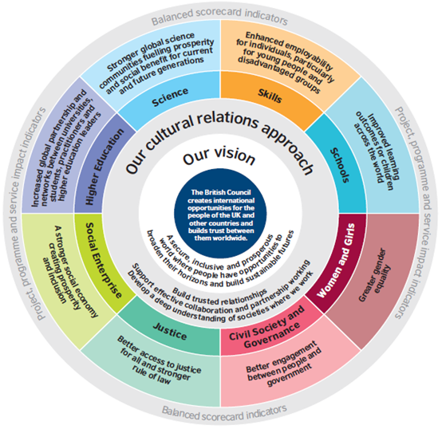
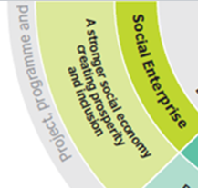
THE BRITISH COUNCIL’S SOCIETY VISION
We seek support societies whose young people, citizens and institutions a contribute to a more inclusive, open and prosperous world by ‘leveraging UK leadership in social enterprise’ which is one of four key themes for our Society work.

Slide 5
Social enterprise - definition
“ a business that tackle social and environmental problems and work in communities to improve people’s lives. Social enterprises can included charitable non-profit or business that make money. The majority of social enterprises reinvest their profits in the communities they work in.”
G8 factsheet: social investment and social enterprise (published: 3 Jun 2013)
https://www.gov.uk/government/publications/g8-factsheet-social-investment-and-social-enterprise/g8-factsheet-social-investment-and-social-enterprise

Slide 6
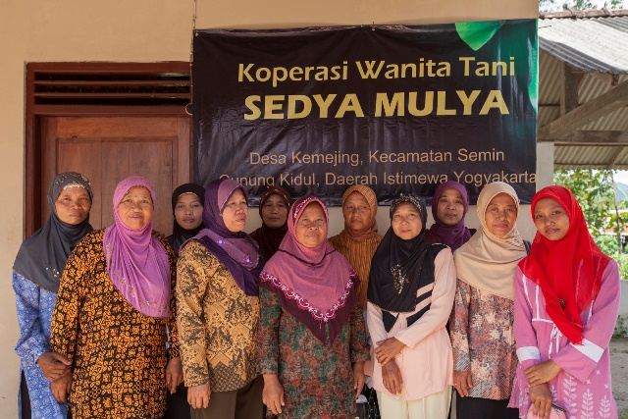
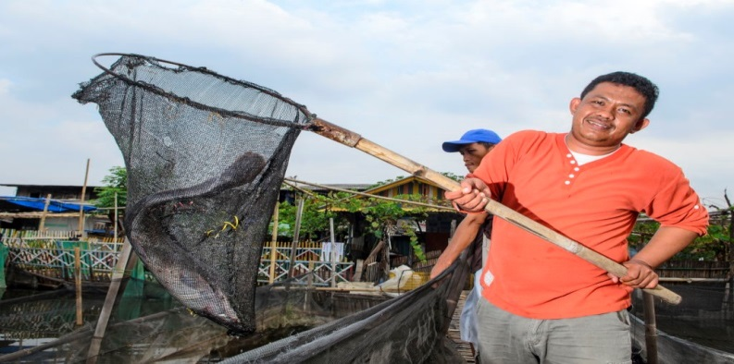
Social enterprise - Characteristic (Social enterprise uk)
Social Enterprises should:
Have a clear social and/or environmental mission set out in their governing documents
Generate the majority of their income through trade (revenues mainly from goods and services provided, not grants or donations)
Reinvest the majority of their profits
Be autonomous of state
Be majority controlled in the interests of the social mission
Be accountable and transparent
(The characteristics of a social enterprise)
https://www.socialenterprise.org.uk/Handlers/Download.ashx?IDMF=96f544c0-eb5c-404a-92a2-e040e49148f9

Slide 7
FOUR TYPES OF STAKEHOLDERS
Four types of stakeholders (key players) exist in the social entrepreneurship ecosystem:
Social Enterprises (SEs): Indonesia has a relatively large number of Social Enterprise (±1400 Social Enterprise), but most of these are still in the seed and venture stages. Significant challenges face SEs as they seek to move from the venture stage to growth.
Social Investors: currently hold relatively moderate investments in Social Enterprise in Indonesia
Social Enterprise Enablers: have moderate presence in Indonesia.
Target Communities: target communities are abundant in Indonesia, and potential customers and target groups are receptive to Social Enterprise.
Based on Boston Consulting Group (BCG) Report – The Art of Sustainable Giving, 2015

Slide 8
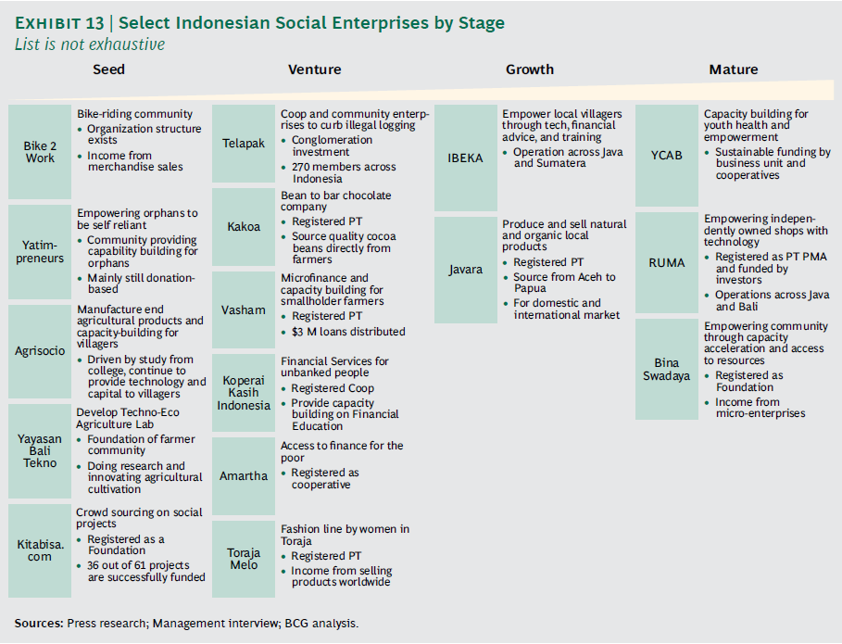
STAGE OF SE IN INDONESIA

Slide 9
priorities for increasing se IN indonesia
Strengthen social entrepreneurs and their capabilities
Attracting and nurturing talent for SEs
Increasing the number of SE accelerators
Magnify the impact of enablers
Orchestrating efforts to grow the SE ecosystem
Accelerating ease of doing business in Indonesia
Attract more social investors
Establishing proof of concept in impact investing
Based on Boston Consulting Group (BCG) Report – The Art of Sustainable Giving, 2015

Slide 10
IdeaS FOR Solutions to the SE issue based on British Council-Pulse lab jakarta co-design workshop for se ecosystem, march 2017
How might we collaborate (all SE stakeholders)
To empower Social Enterprise and to measure success every step of the way
Develop application of basic business matrix for SE (application, self-training, monitoring program an incentive, etc.)
To facilitate Social Enterprise in finding their soulmate
(Re)activate SE networks
Regular networking session online and offline (conference, coworking space, digital community)
To monetize Social Enterprises initiatives
To advocate for a more Social Enterprise friendly regulation
Advocate to relevant ministries about SE
To better enable Social Enterprise to empathize to their consumers
Make the SE see and feel from the consumers point of view

Slide 11
British council – theory of change
Transformative Narratives
Thought Leadership
Capacity Building
Economic systems that benefit people and planet
Policy and Government Engagement
International
(ecosystem/
sustainable) Development
Education Systems
Engagement Infrastructure
Partners; platforms; portal

Slide 12
Super Impact
Sustainable development Goals 8 and 10 are achieved
BC Corporate outcomes achieved (see our Cultural Relations model)
Impact
Social and creative entrepreneurs address entrenched social problems and deliver positive change to their communities
Social and Creative Enterprises are an integral part of the Economy
The social impact created by social and creative enterprises is widely understood and accepted
Outcomes
Business development and social investment infrastructure exists and is accessible to social and creative entrepreneurs
Appropriate polices and legal forms exist to support social and creative enterprises
Governments, the private sector and the general public are buying from social and creative enterprises
Result statement: Social and creative entrepreneurs have the skills to be employable and to build inclusive and creative economies which support stable and prosperous societies
Outputs
Policy makers have increased knowledge and understanding of how to develop policies to support social and creative enterprises/entrepreneurs
Robust evidence exists of the impact created by social and creative enterprises/ entreprenuers
Social and Creative Entrepreneurs have enhanced capacity to build impactful social and creative enterprises
Social investors have greater understanding of how to develop appropriate financial instruments to support social and creative entrepreneurs
Governments, the private sector and the general public have greater knowledge of where to buy products and services from social and creative enterprises and how these enterprises create social impact
Interventions
Develop the knowledge and skills of policy makers e.g. organise policy dialogues and training for policy makers
Conduct research including social enterprise surveys, policy landscape studies and sector and audience analysis (women, youth, education)
Business development support to social and creative entrepreneurs
Raise awareness amongst the general public, government and the private sector in order to build a market place for social and creative enterprises
Barriers
Lack of knowledge, skills and confidence of policy makers of the impact of the social and creative economy
Lack of evidence of the impact that social and creative enterprises can have
Social and Creative Entrepreneurs lack skills, knowledge and networks
Social and Creative Entrepreneurs struggle to access appropriate financial instruments
Social and Creative Entrepreneurs do not have appropriate policies and legal frameworks to support them to grow
Problem
A lack of economic justice. Social and Creative Entrepreneurs lack access to skills, finance and networks which would help to grow their enterprises. This is compounded by an inadequate policy and regulatory environment in many countries.

Slide 13
British council - Social Enterprise programmes
CAPACITY BUILDING
EDUCATION SYSTEM
Social Enterprise for Higher Education
INTERNATIONAL DEVELOPMENT Supporting Policy Makers in Understanding SE
(Ecosystem / Sustainable)
Community based SE Workshops
Active Citizen SE Leadership
Training
Workshop on Curri. Dev., Intro to SROI, etc.
Study Visit
Study Visit
Active Citizen,
NGOs
Business & Investment Readiness,
Catalyst
Active Citizens
Training
Collaboration with other org. to support ecosystem dev.
Workshops. Discussion,
Research, Policy, Dialogue
British Council support for Social Enterprise with UK Expertise that brings benefit to UK and Society in Indonesia
Notes:
Diskusi dengan beberapa perguruan tinggi terkait:
1. Pengembangan perguruan tinggi yang socially entrepreneurial
2. Bagaimana memasukan konsep social enterprise ke dalam kurikulum
3. Memfasilitasi hubungan staff perguruan tinggi, mahasiswa dan komunitas melalui pendekatan social enterprise
4. Perguruan tinggi sebagai hub dan penyedia pengembangan profesional dalam Social Enterprise dan untuk penelitian mengenai social impact

Slide 14
BRITISH COUNCIL SOCIAL ENTERPRISE PROGRAMME IN INDONESIA SINCE 2010
Social Enterprise in Indonesia has a relatively large number, but most are still in the seed and venture stage
British Council Indonesia has given capacity building to more than 1,000 Social Enterprise through:
Community Enterprise Challenge
NGO transformation to Social Enterprise
Active Citizens Social Enterprise Leadership Training in Bandung, Jakarta, Makasar, Surabaya, Kupang, Bogor, Bali, etc
SE Legal Discussion – collaboration with Social Corporate Lawyers Society (Socolas)
Most of the SE from Agriculture, Education, Health, Arts & Creative sectors

Slide 15
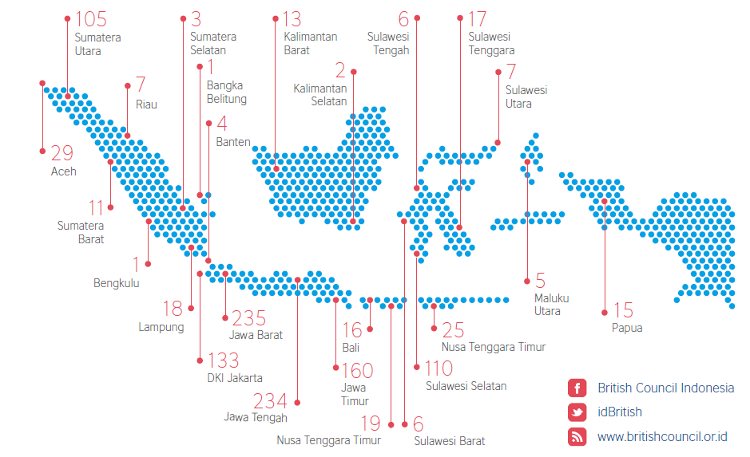
British Council: CEC 1-4, SEC 2015, NGO Trans, ACSE
> 3000
1000
Social Ent. applied
Social Enterprises Selected & Trained

Slide 16
Some of our Social enterprise championS & network
Amartha – Fintech – Jakarta, DKI Jakarta
YCAB SE – Education, Child Empowerment – Jakarta, DKI Jakarta
Indonesia Medika – Health – Malang, EastJava
Code Margonda – Community Space – Depok, West Java
Baraka Nusantara – Education, Farming – Lombok, NTB
Desa Wisata Ekologis (DWE) Nyambu – Ecotourism – Tabanan District, Bali
Yayasan Pelangi Nusantara (Pelanusa) – Arts & Creative, Women Empowerment – Malang

