Slide 1
Inequality in Asia and the Pacific

Slide 2
Inequalities are multidimensional
Outcome
Income
Wealth
Opportunities
Health
Education
Population Groups
Women/ Men
Rural/ Urban
Water, Sanitation, Energy
Employment
Ethnicity/ Religion

Slide 4
Inequality of Opportunities
Decent jobs
Education
Voice
Health
Clean Energy
Water and Sanitation

Slide 5
Opportunity: as access to electricity falls, inequality increases

Slide 6
Horizontal Inequalities
Excluded (e.g. persons with disabilities, women)
No education
No health care
No voice
No clean water, sanitation, electricity
No decent job

Slide 7
Horizontal inequalities: e.g. Caste, Rural
In India: caste is still the 3rd most important factor in determining access to a range of opportunities (1st: wealth, 2nd: residence)
In Indonesia: opportunity gaps are closing, but more slowly for residents of rural areas, outside Java

Slide 8
Women are more represented in vulnerable employment
_{Source: ILO estimates}

Slide 9
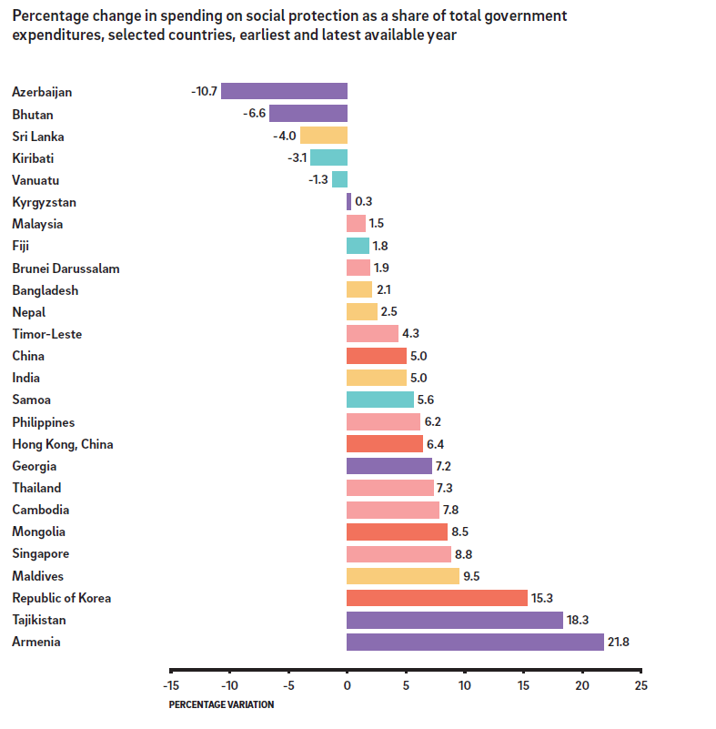
However, some positive trends: increased spending on social protection
Source: ESCAP, based on ADB Key Indicators for Asia and the Pacific, 2014

Slide 10
For more information:
Email: escap-sdd@un.org
Website: www.unescap.org
Notes:
So I thank you for your time and welcome your questions.

