Slide 1
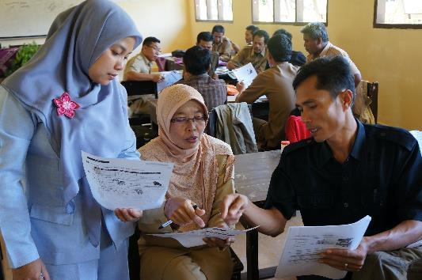
Merancang solusi bersama untuk pembelajaran di kelas yang lebih baik
Solusi konteks lokal untuk menjawab tantangan lokal
Notes:
“Co-designing local solutions for a better classroom learning”

Slide 2
Apa itu INOVASI?
Pendekatan INOVASI
Implementasi
Kontribusi INOVASI
①
②
③
④

Slide 3
INOVASI
Pendidikan Dasar
Belajar-Mengajar
Literasi dan Numerasi
Kolaborasi
Pendekatan PDIA
Inklusif
Notes:
INOVASI’s design is underpinned by the belief that many reform initiatives aiming to improve student learning outcomes in Indonesia are designed with a one size fits all solution. These are not always relevant for Indonesia and its many diverse cultural contexts.
INOVASI solutions and pilot activities focus on how to improve literacy and numeracy learning in primary schools, through strengthening classroom practice, improving support to teachers and ensuring that all children in the classroom are able to learn. Solutions and pilot activities are locally derived with national education priorities in mind.
INOVASI explores how to improve learning outcomes in literacy and numeracy by using a distinctive approach designed to find local solutions to local and particular challenges in learning.
Focussed on the individual education challenges of districts and provinces
Locally derived solutions
Solutions co-designed with local stakeholders
Findings and learnings disseminated

Slide 4
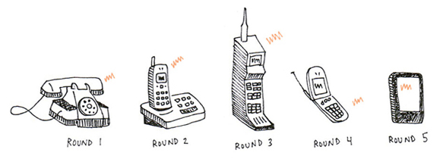
Pendekatan PDIA
Problem Driven Iterative Adaptation
Problem Driven
Iterative
Adaptation
Notes:
Including why we do PDIA instead of top-down approach

Slide 5
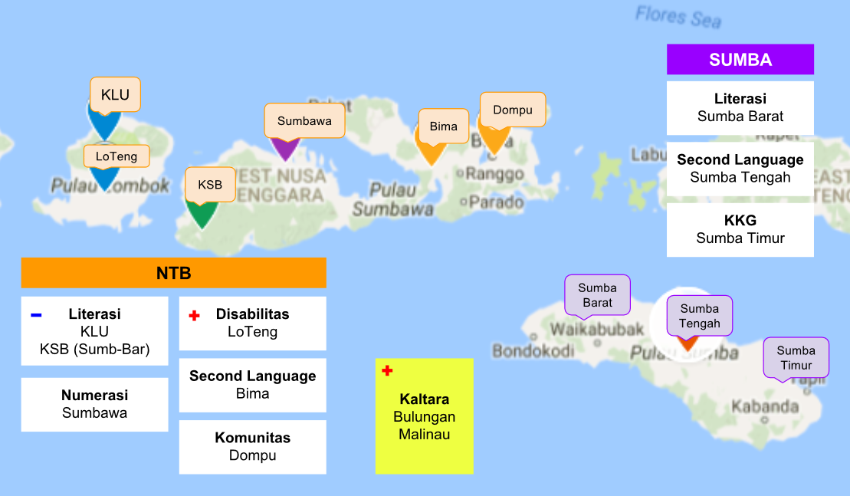
Guru BAIK
Sumba Barat Daya
Sumba Barat Daya

Slide 6
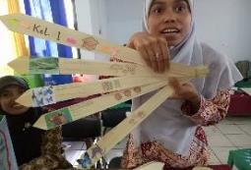
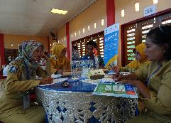
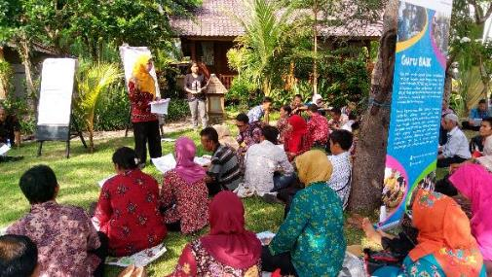
Bentuk Implementasi
kegiatan Guru BAIK di NTB
Analisis Masalah Pembelajaran
Tindakan dan Refleksi
Penemuan Masalah Pembelajaran
Desain Tindakan
Desain Evaluasi
①
②
⑤
③
④

Slide 7
Kontribusi INOVASI
Kapasitas Lokal
Pilot
Konteks Lokal
Praktisi dan pemangku kepentingan daerah terbekali dengan kapasitas menyelesaikan masalah lokal
Pemangku kepentingan akan terbekali dengan data/informasi mengenai pendekatan efektif guna peningkatan kualitas pembelajaran
Notes:
How INOVASI contribute to the acceleration of reducing inequality in Indonesia?

Slide 8
Thank You
Notes:
Thank you for your time and attentions, we are happy to answer any questions you have.

