Slide 1
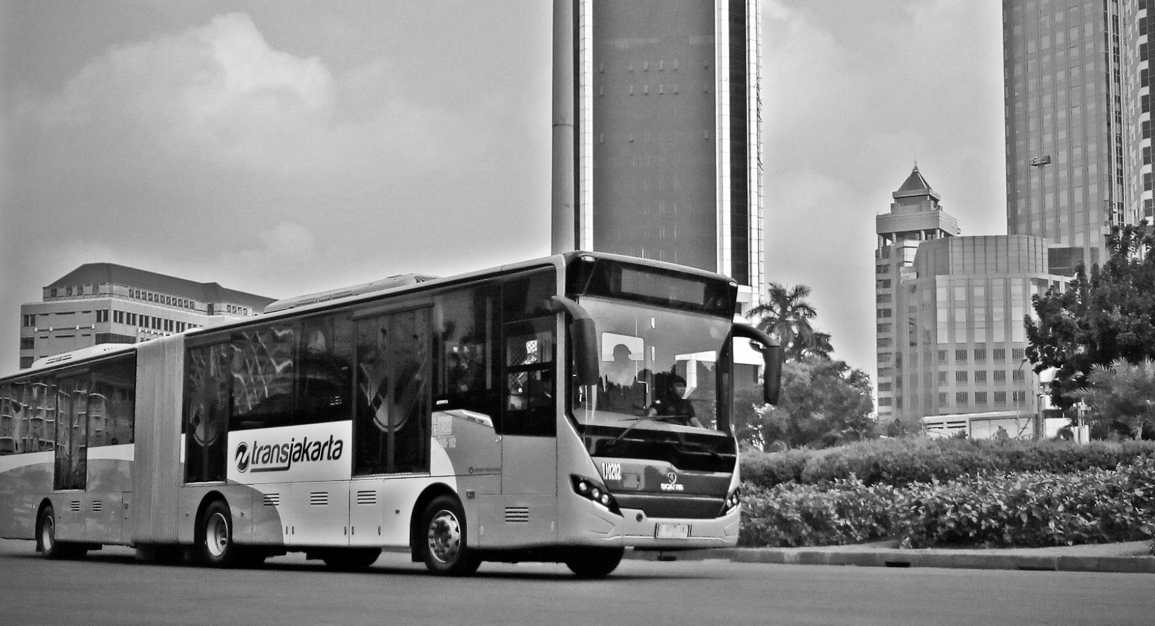
Better Understanding TransJakarta Passengers’ Travel Behaviours
Using Data Analysis
Yulistina Riyadi
Research Associate, Pulse Lab Jakarta

Slide 2
DATA SOURCES
Passenger Tap Information
Traffic Condition Data
Weather Data
72 million transaction records from 3.12 million smart transportation cards
More than 1 million reports from Waze
Historical weather data in Jakarta from CHIRPS (Climate Hazards Group InfraRed Precipitation with Station)

Slide 3
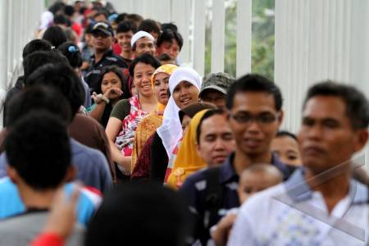
OBJECTIVES
Q1
Can we identify hidden patterns in the travel behaviours of regular passengers based on AFC data?
Do traffic dynamics and weather dynamics influence regular passengers to change their travel behaviours?
If so, what is the relative strength of the two factors in terms of their influence on the travel behaviours of regular passengers?
Q2
Image source: Kompasiana
14.09%
of the population in Jakarta are commuters
Q3
million
1.38
people commute from Greater Jakarta to Jakarta
Source: BPS (2014)
Source: BPS (2014)

Slide 4
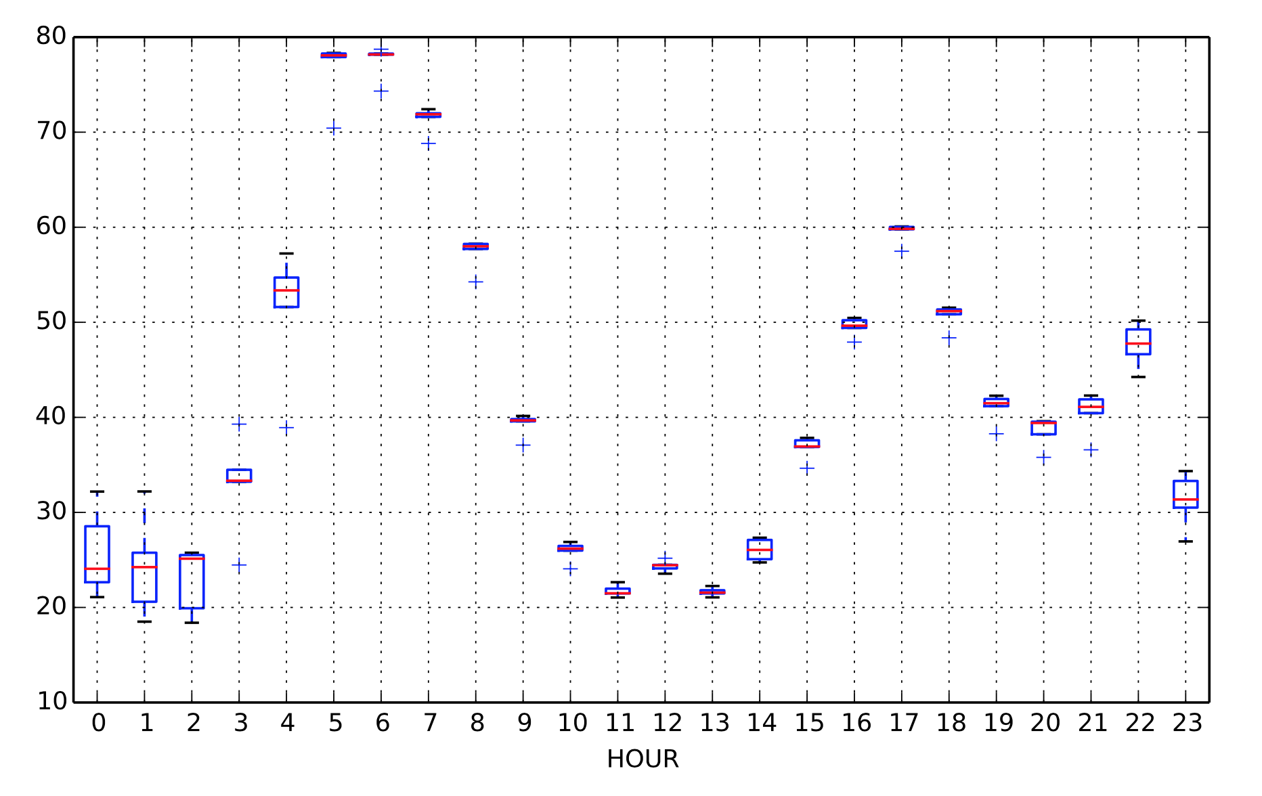
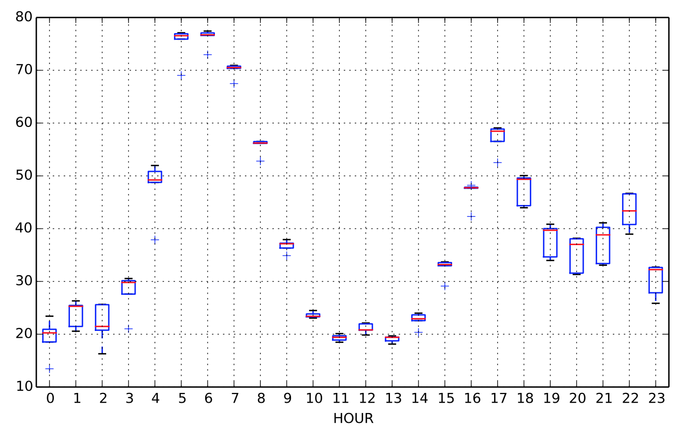
Regular Trips by the Two External Factors
%
%
Hour
Hour
Normal Traffic & Weather (Mon-Thu)
Bad Traffic

Slide 5
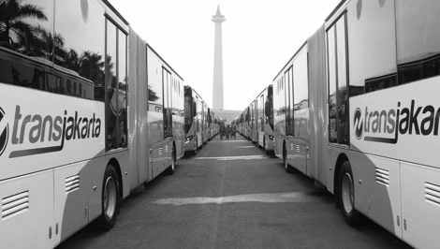
Harnessing data for development
Translating insights for social innovation
plj@un.or.id
@PulseLabJakarta
@PulseLabJakarta
@PulseLabJakarta
pulselabjakarta.id
Image source: detik.com

