Slide 1
Addresing Inequality
In Local Goverment

Slide 2
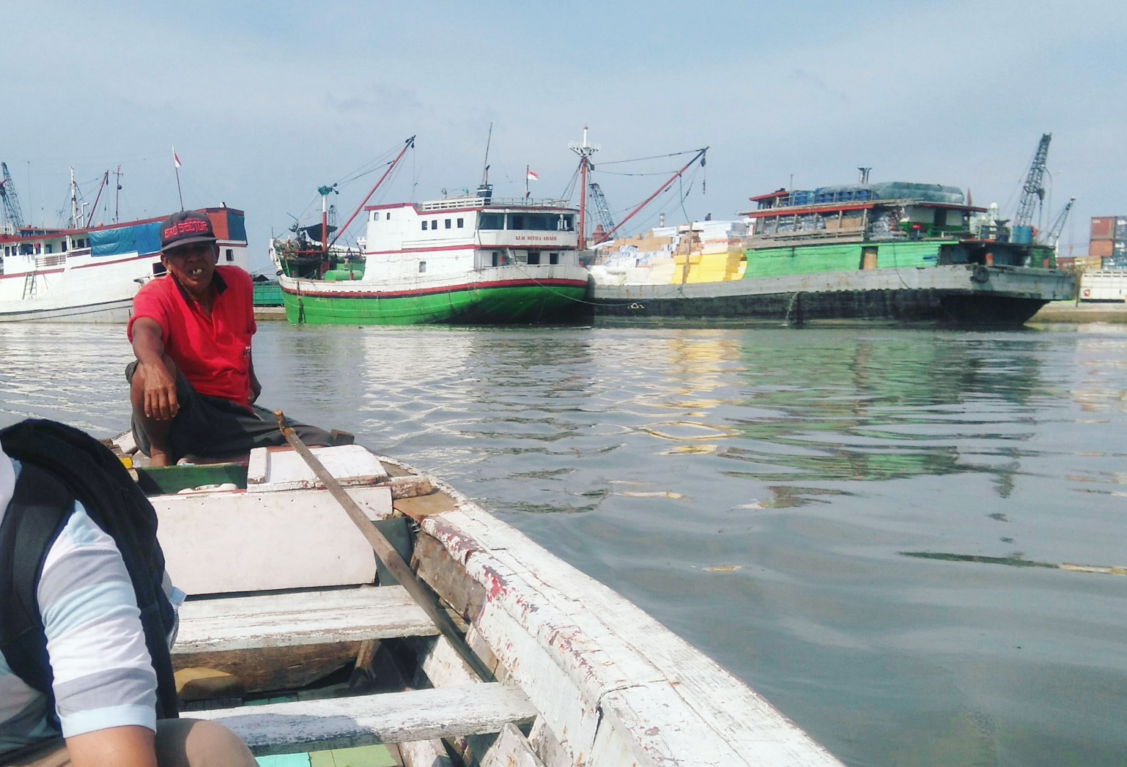
Jebakan Kemiskinan
Receive intervention & stimualtion
regeneration
Quality Education
Born in poverty
Form a family
Success & positive experiences
Competent, self –confidence, & stable job
Completed Education process

Slide 3
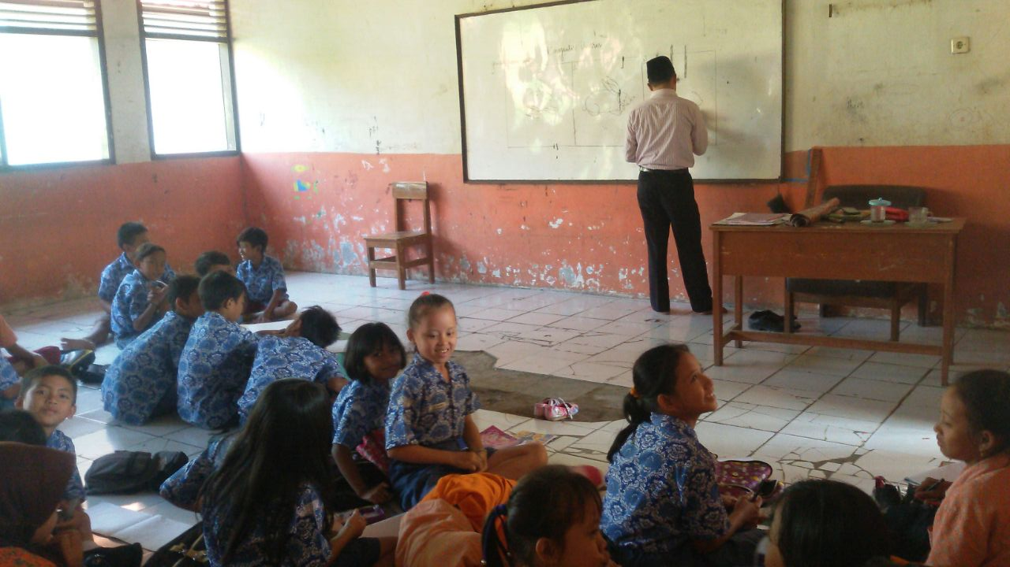
Pemerataan
Sarana dan Prasarana

Slide 4
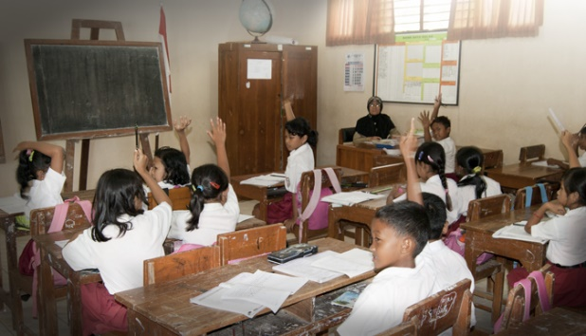
Kualitas Pengajar

Slide 5
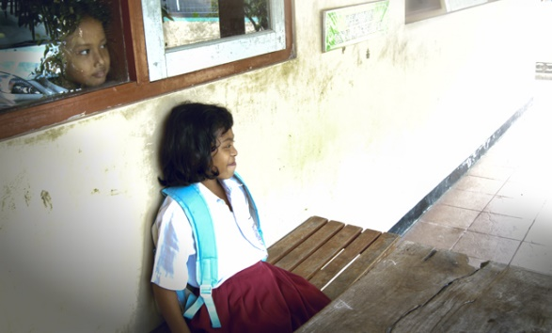
Public Expenditure Review

